Slide 1

“Where Technology Meets Empowerment”

Slide 2
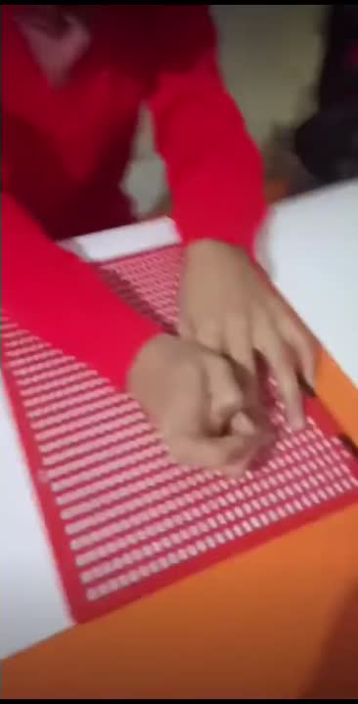



Slide 3


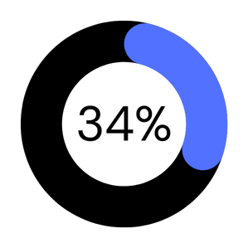
BRAILLE PRINTER
VISUALLY CHALLENGED PEOPLE
LOW INCOME

Slide 4

Customer segments

Slide 5





Slide 6

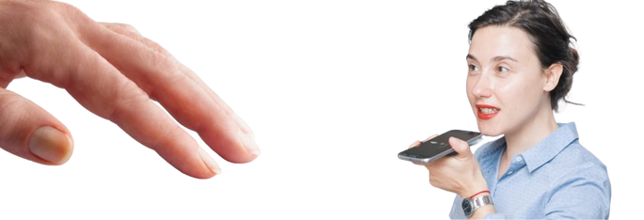


Slide 7

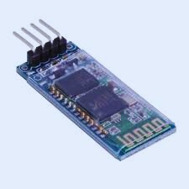


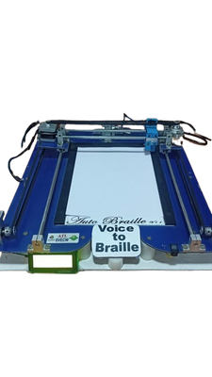
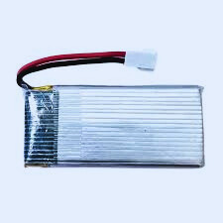
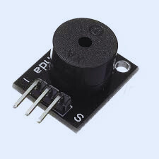
MICROPROCESSOR
BLUETOOTH
PROTOTYPE
BATTERY
BUZZER

Slide 8

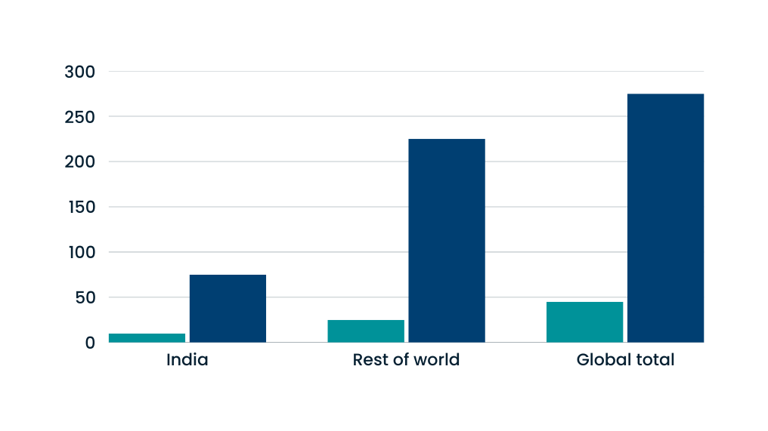
Blind and Visually Impaired Population :India vs Global
BLIND POPULATION(MILLIONS)
VISUALLY IMPAIRED POPULATION(MILLIONS)
population(million)

Slide 9


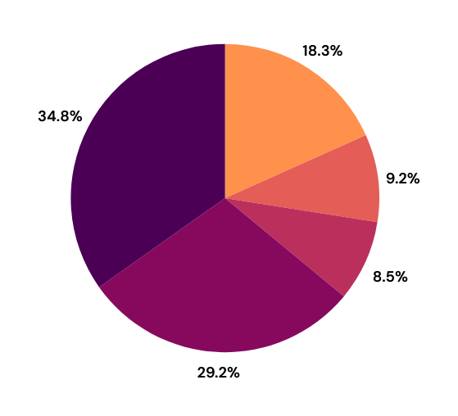
BRAILLE LITERACY
Non-Readers
Auditory Readers
Pre Readers
Print Readers
Braille Readers

Slide 10





COMPETITION ADVANTAGES

Slide 11
FEATURES
BRAILLE CONVERTER
SLATE & STYLUS
VOICE TO BRAILLE
FEATURES
TEXTURE
PRICE
FINISHED LOOK
COST
SPEED
PORTABILITY
MAINTENANCE
EASY OF USE
HIGH
SLOW
BULKY
COMPLEX
MODERATE
LOW
VERY SLOW
PORTABLE
NONE
DIFFICULT
AFFORDABLE
FAST
BULKY
MINIMAL
EASY
WWW.REALLYGREATSITE.COM
+123-456-7890
123 ANYWHERE ST., ANY CITY

Slide 12
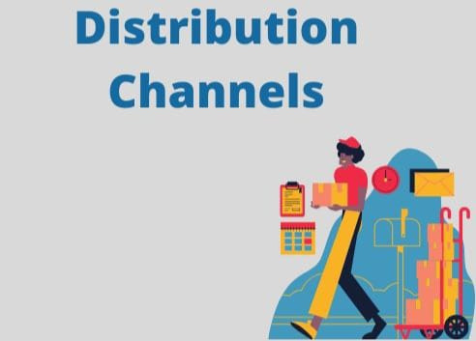

Slide 13





Educational Institutions
Collaboration with NGOs
and CSR
Manufacturing unit
Partnerships with Nonprofit Organizations
Online Marketplaces

Slide 14









01.Direct Product Sales
02.Subscription Models
KEY
MATRIC
03.InstitutionalPartnerships
04. MarketTraining and Support Servicesing
05.Returining customers

Slide 15

FINANCIALS

Slide 16


COST STRUCTURE
Metric | AMOUNT (INR)
COGS(PER UNIT) | ₹600
SELLING PRICE (PER UNIT) | ₹999
CONTRIBUTION MARGIN PER UNIT | ₹399
BREAK-EVEN UNITS (YEARLY) | 1,62,000 units
BURN RATE (MONTHLY) | ₹53,950,00
MARKETING (YEARLY) | ₹66,44,000
ADMINISTRATIVE (YEARLY) | ₹2,07,50,000
R&D Costs (Yearly) | ₹3,73,50,000
Sales Revenue (2,000 units) | ₹19,98,000
Profit (2,000 units) | ₹7,98,000

Slide 17



Slide 18

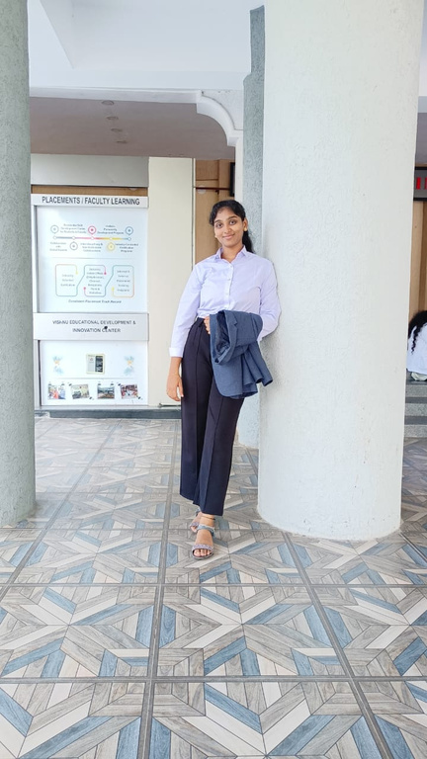
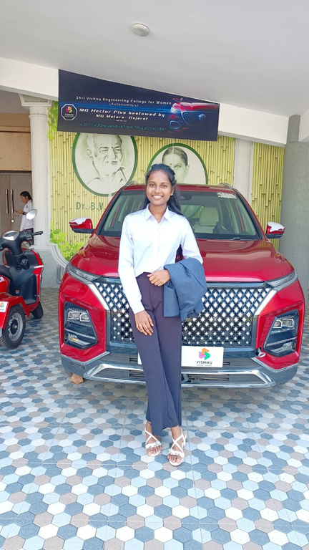
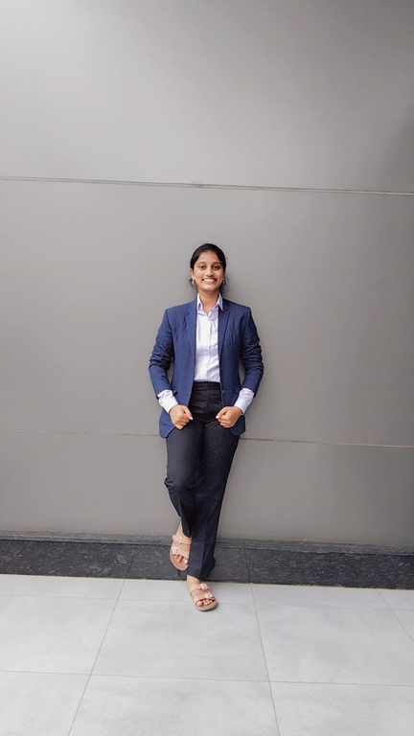

TEAM NEOTECH
G.Sai Sreeja
-Software & Hardware
Manager
CH.Prasanna
-Product Manager
K.Keerthi
- Project Manager

